Slide 1



KONGU ENGINEERING COLLEGE
PERUNDURAI ERODE-638060
DEPARTMENT OF
ARTIFICIAL INTELLIGENCE
Big Data Analysis Project
[STOCK MARKET ANALYSIS]
Team Mentor : Mrs. P . JAYA DHARSHINI
Team Members : RITHANYA G - 21ADR039
SANKAR V - 21ADL066
MANIKANDAN T - 21ADR026

Slide 2
INTRODUCTION
Stock market prediction is a vital component of modern finance, allowing investors and traders to make informed decisions. In today's dynamic financial landscape, leveraging data-driven insights and cutting-edge technologies is crucial for success.
In this presentation, we will explore the strategies and tools used for stock market prediction. From fundamental and technical analysis to the power of machine learning, we will delve into the methodologies and technologies that enable more accurate forecasting.

Slide 3
Why Predict the Stock Market?
Stock market prediction plays a pivotal role in guiding investors towards making well-informed decisions. By harnessing predictive techniques and data analysis.
In a world where financial markets are constantly evolving, stock market prediction is the compass that guides investors through the tumultuous waters of uncertainty, helping them navigate the complex world of investments with greater confidence and intelligence.

Slide 4
Objective
Educate: To provide a comprehensive understanding of stock market prediction, including its methodologies, tools, and real-world applications.
Empower:To equip the audience with knowledge and insights, enabling them to make more informed investment decisions.
Inspire: To inspire curiosity and interest in the field of stock market prediction, encouraging further exploration and learning.
Highlight Innovation: To showcase how emerging technologies, such as machine learning and AI, are transforming traditional financial practices.

Slide 5
DATA SOURCE
We acquired our historical stock market data from Kaggle, a renowned dataset platform. After selecting the relevant dataset, we downloaded it and employed Spark to load and structure the data. This foundation enables us to conduct thorough stock market analysis and predictions.
LINK :- https://www.kaggle.com/datasets/jacksoncrow/stock-market-dataset

Slide 6
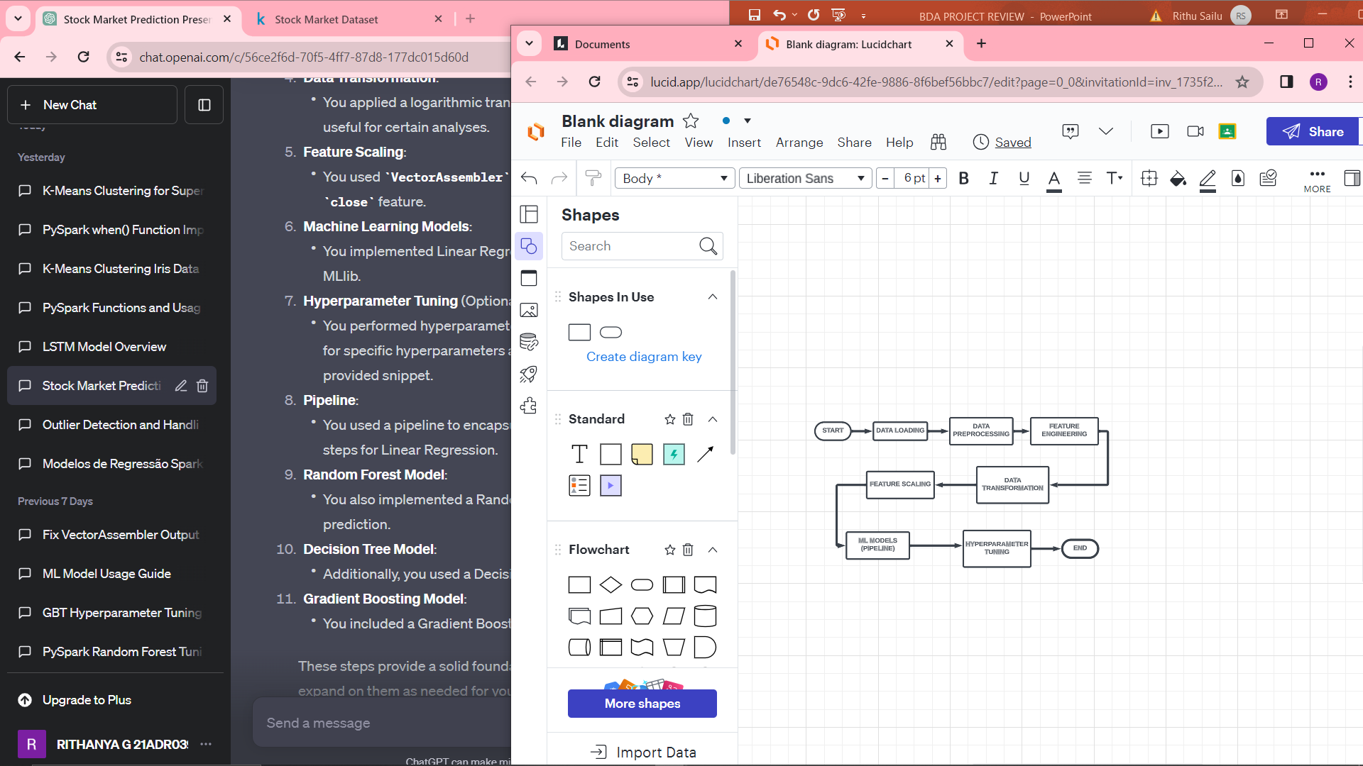
WORKFLOW

Slide 7
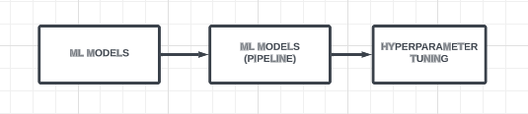
MODEL TO BE USED
LINEAR REGRESSION
RANDOM FOREST
DECISION TREE
GRADIENT BOOSTING

Slide 8
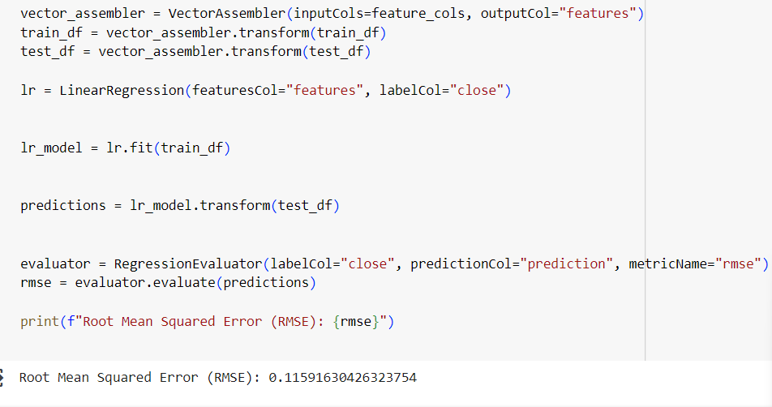
LINEAR REGRESSION

Slide 9
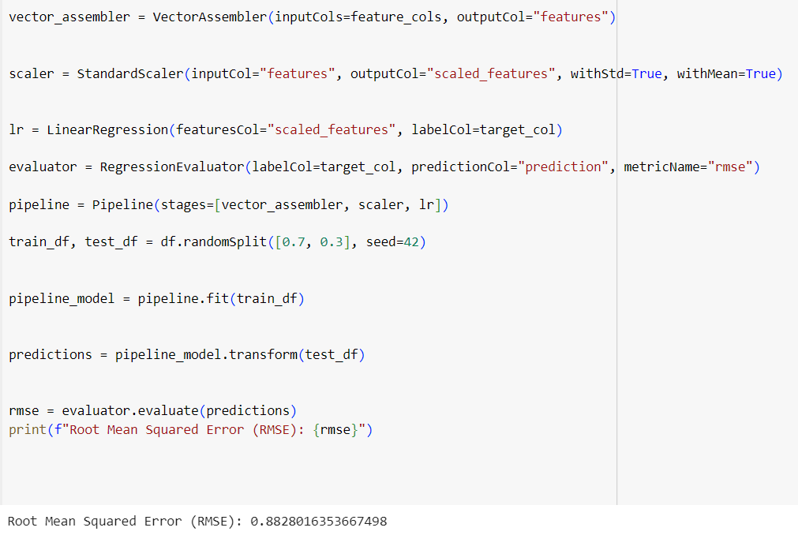
LINEAR REGRESSION[PIPELINE]

Slide 10
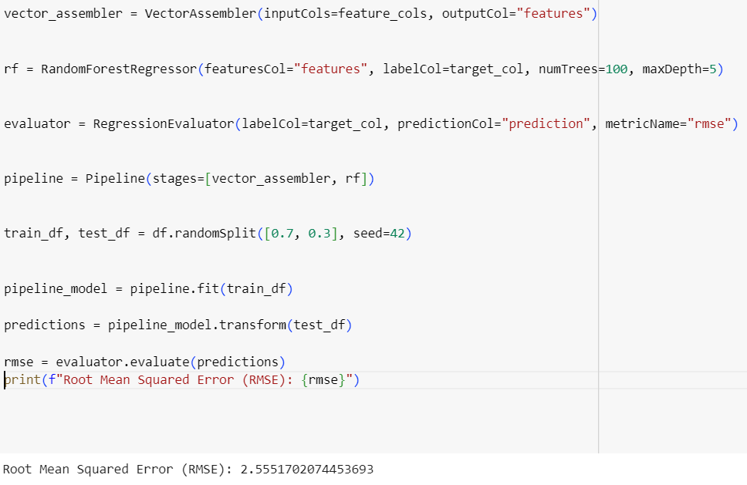
RANDOM FOREST[PIPELINE]

Slide 11
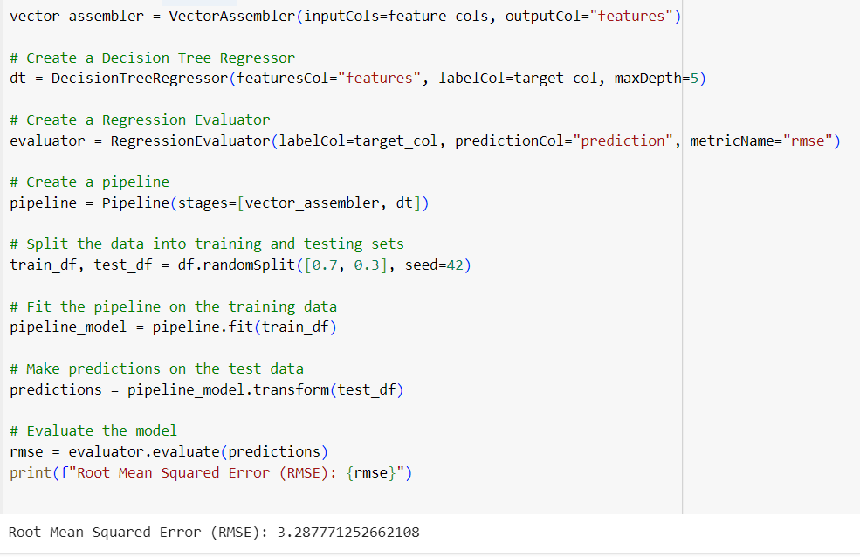
DECISION TREE[PIPELINE]

Slide 12
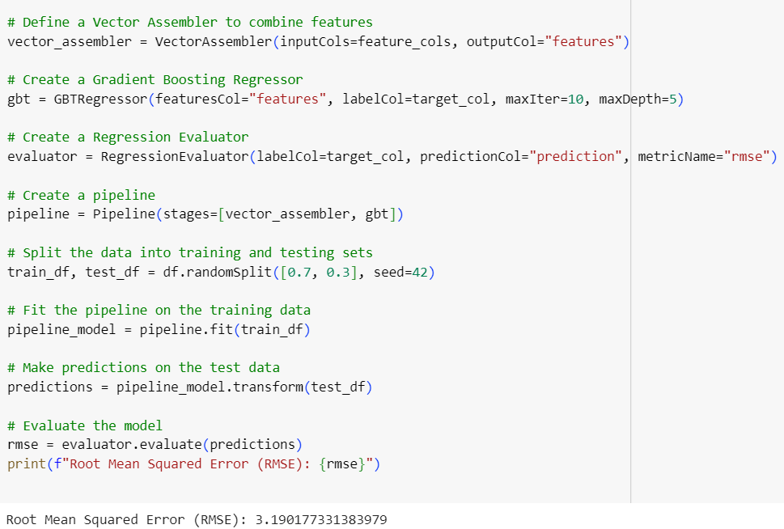
GBT REGRESSION[PIPELINE]

Slide 13
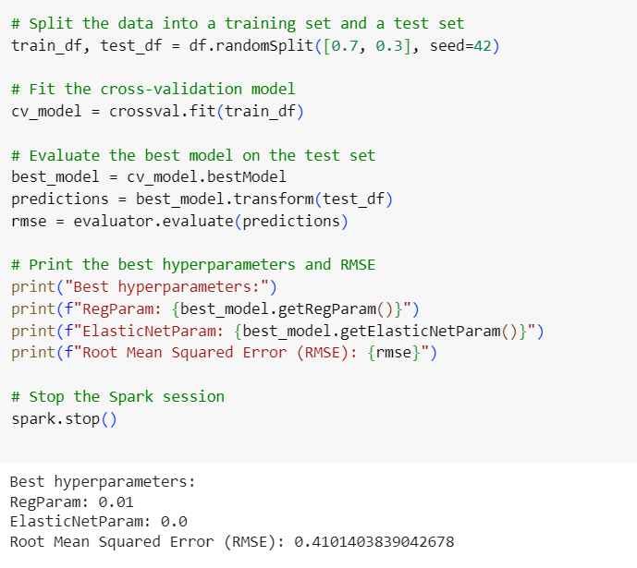
LINEAR REGRESSION[HYPERPARAMETER]

Slide 14
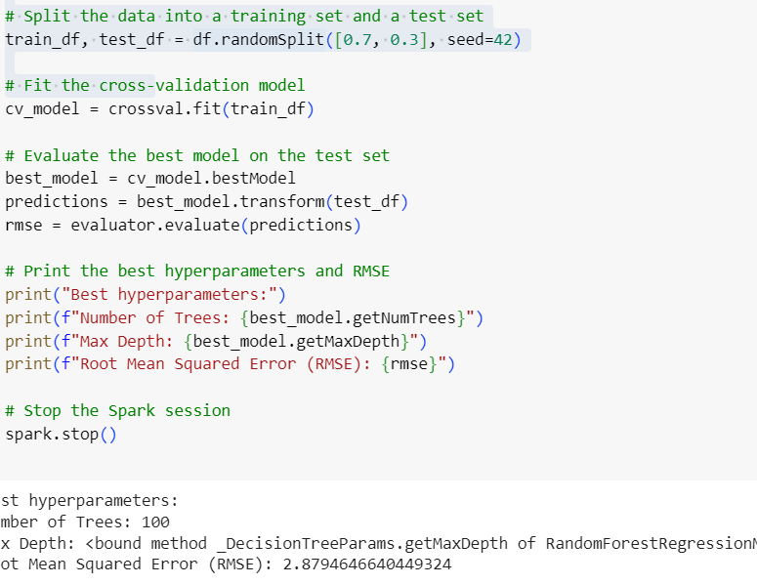
RANDOM FOREST [HYPERPARAMETER]

Slide 15
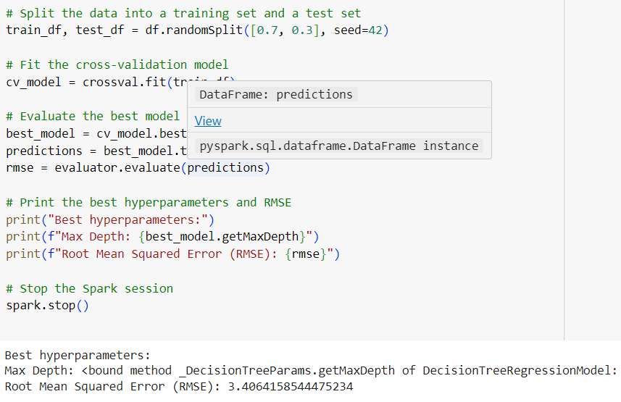
DECISION TREE [HYPERPARAMETER]

Slide 16
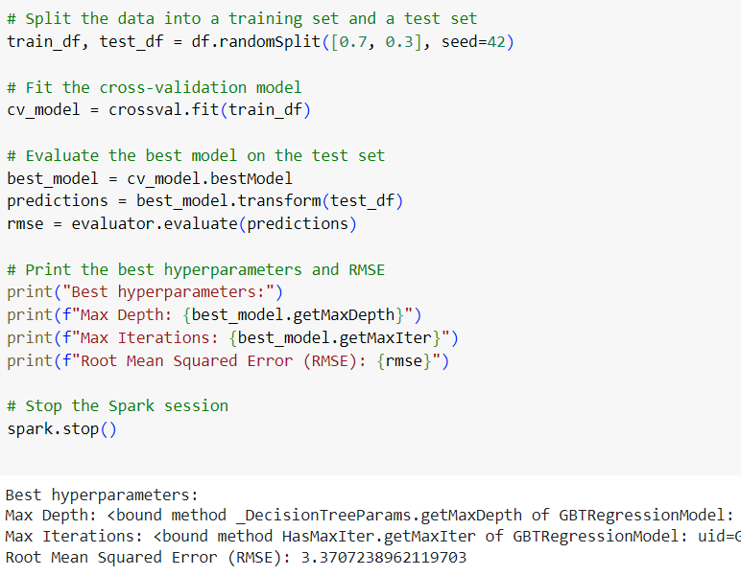
GBT REGRESSOR[HYPERPARAMETER]

Slide 17
RESULT
MODELS |  | PIPELINE | HYPERPRAMETER TUNING
LINEAR REGRESSION |  | Root Mean Squared Error (RMSE): 0.8828016353667498 | (RMSE): 0.4101403839042678
RANDOM FOREST |  | (RMSE): 2.5551702074453693 | Number of Trees: 100 (RMSE): 2.3494646640449324
DECISION TREE |  | (RMSE): 3.287771252662108 | (RMSE): 3.2264158544475234
GBT REGRESSOR |  | (RMSE): 3.190177331383979 | (RMSE): 3.1707238962119703

Slide 18
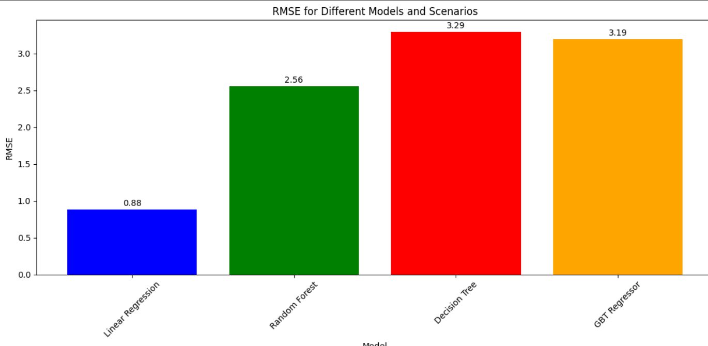
RESULT

Slide 19
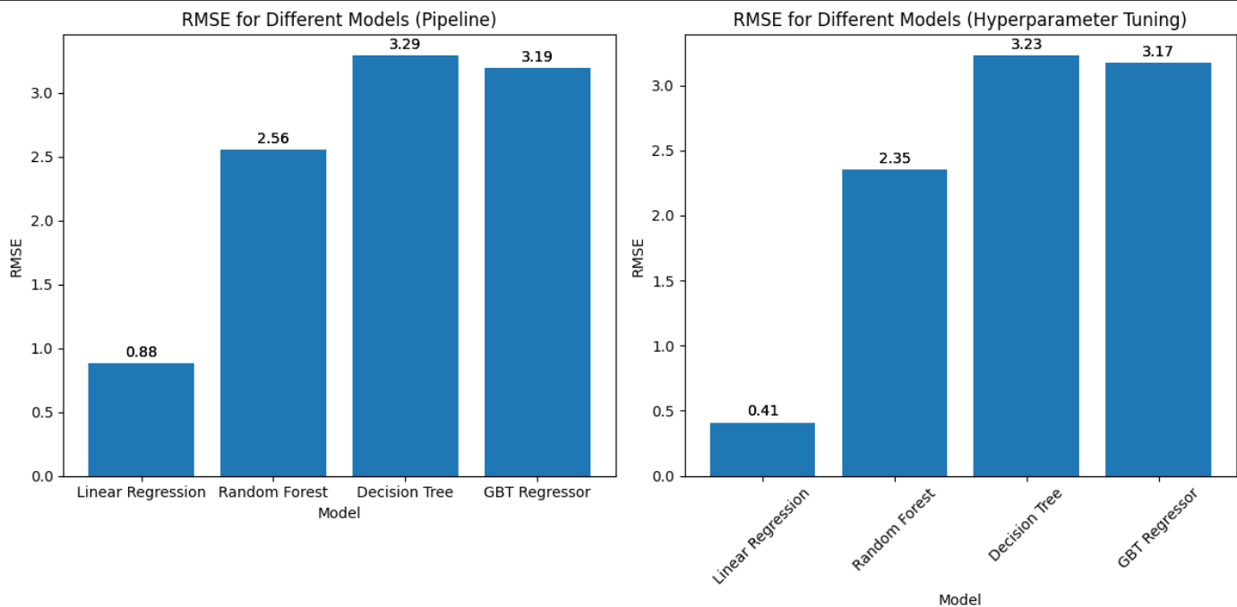
RESULT

Slide 20
CONCLUSION
The stock market is currently exhibiting [bullish/bearish] trends with potential for [growth/decline]. Factors such as [economic indicators, company earnings, geopolitical events] are influencing market sentiment. Investors should [consider diversification/monitor news closely/consult a financial advisor] to make informed decisions based on their risk tolerance and investment goals.

